Slide 1
场景设计
Xin Zou
2015
构建之法 – 现代软件工程

Slide 2
Scenario != sum(functions)
茶壶的功能
茶壶盖
茶壶体
茶壶把
茶壶嘴
各个功能还要有机结合起来，满足用户的需求
下面的茶壶满足了用户的需求了么？

Slide 3


Slide 4
Example 1
Academic Search
Author Citation Graph
I want to check out other people’s graph

Slide 5
Example 2
After installing a new English Windows OS, need to find latest Chinese IME
Result: can’t find it
Expect: user need to type the Chinese “IME” in search

Slide 6
Scenario ！= demo
Story of coke vs. Pepsi
First Taste vs. long term taste
Scenario means
Experience in first 3 minutes
Long term experience

Slide 7
Example 3
Genealogy in Academic Search
Looks cool at first sight
What’s the long term value?

Slide 8
Example 4
“Minority Report”

Slide 9
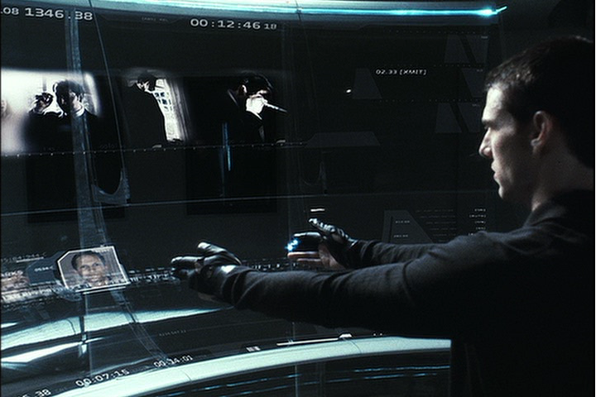

Slide 10
Working like that for 8 hours?
It’s cool on demo, but your arms will become very tired when using it for a long time.
According to Andy Van Dam, the movie crew hung Tom Cruise’s arms after he become so tired after a while

Slide 11
Example 5
A foreign student needs to set up online banking in China
Go to bank web site, change language to English
Finish the require steps
Bank sends a password to user’s cell phone via SMS
Problem
The SMS is in Chinese Text, not English
the foreign student’s cell phone can’t display, he can’t read it either!

Slide 12
Features have to work together, seamlessly
You work on a reader app, it has a dictionary, you have 2 features:
Download the dictionary
When click a word, show the dictionary entry, if no dictionary is present,
A) throw out an exception
B) a dlg to promote user to download
C) secretly download
D) cancelable download
Notes:
What if you don’t want to download, or your network is disconnected?

Slide 13
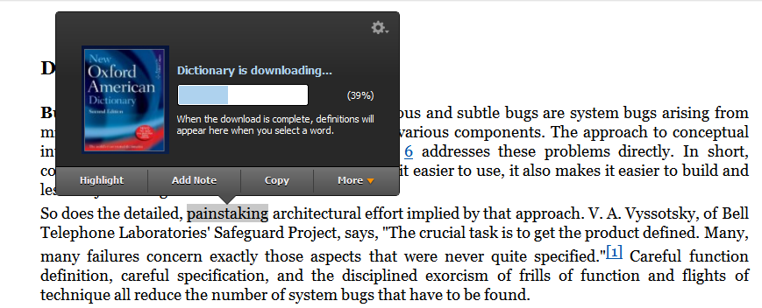
Kindle for PC
Notes:
第一次下载 Kindle for PC 的时候并没有下载词典；当用户第一次触发词典这个功能的时候，才提示用户，并开始下载。

Slide 14
Persona & Scenario
Persona interact with software
Persona has a “need”
Persona uses the software to solve the “need”, in multiple steps.
Persona’s need is solved, he/she is happy

Slide 15
Persona – used in Visual Studio
Challenges for Visual Studio Team
there are millions of customers, using the software in different ways, for different purpose…
VB, C#, C++, MFC, asp.net, J#, TFS, .Net Framework
Hobbyist, students, professionals,
Server, PC, embedded, web,
Team size – 1..1000
Different culture and country
how to design the next version to satisfy most of them?
How to make sure the target customers get the benefit from end-to-end?
There are 500 developers working in VS team, how do we convince all of them agree on serving the same group of customers?

Slide 16
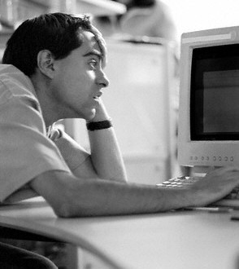
Mort
Mort
Mort, the opportunistic developer, likes to create quick-working solutions for immediate problems and focuses on productivity and learn as needed.
Mort is someone who doesn't consider programming their main job. Maybe they are a statistician, biologist, or construction estimator, who also knows quite a bit about programming. They are opportunistic, using whatever tool comes to hand that will get the job done.
Notes:
http://blogs.msdn.com/ericwhite/archive/2006/05/11/595693.aspx

Slide 17
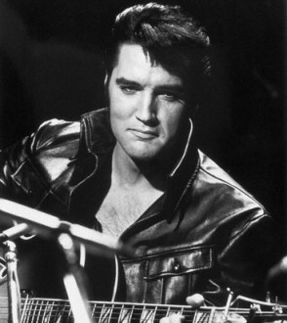
Elvis
Elvis the pragmatic programmer, likes to create long-lasting solutions addressing the problem domain, and learning while working on the solution.
Elvis: journeyman developer.
You can scope out a job and give it to them, and the job will get done. In general, Morts don't become Elvises. Morts want to do their main job; they don't WANT to become a professional developer. Elvises go to school and get CS degrees.

Slide 18
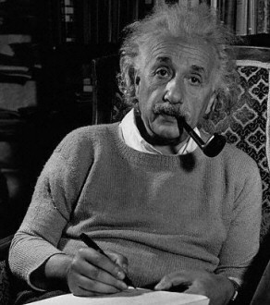
Einstein
Einstein, the paranoid programmer, likes to create the most efficient solution to a given problem, and typically learn in advance before working on the solution.
Einstein is a smart Elvis who has lots of experience.
Einstein can see the big picture. An Einstein often is in a position of responsibility, choosing technologies and designing large software systems.

Slide 19
Specific Personas
Examples:
a library that makes explicit use of parsers and abstract expression trees
Einstein
forms library that allows developers to set properties to connect to database tables
Elvis
A set of Excel macros
Mort
In a way, these personas have helped guide the design of features during the Whidbey (Visual Studio 2005) product cycle.
Notes:
http://blogs.msdn.com/ericwhite/archive/2006/05/11/595693.aspx

Slide 20
用户/需求分析
找到典型用户
我们就是研究院的研究员，难道我们还不是典型用户?
不是！
典型用户
Senior Researcher
Junior Researcher
Students
专业人士研究用户的UX/UI 需求
找到还没有被满足的需求

Slide 21
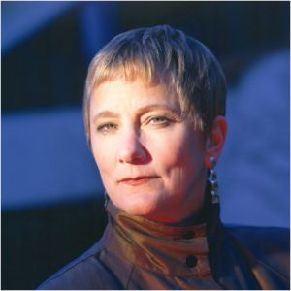
Anita – Senior Research
Researcher working in industrial lab (e.g. MSR researcher)
Education: PhD, Age: >=35, h-index > 20,
PAIN:
Hiring someone / check background
As Chair person, pick reviewers, PC member
Read/organize paper
Care about “my rank” in the domain, and correctness, completeness of my profile,
Care about rank of my dept.
Already know lots of people in such domain, knowing people is not top priority
Big influencer

Slide 22
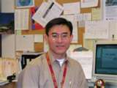
John – Junior Researcher
College assistant professor
Handling both teaching and research
PAIN:
How to let more people know about my work?
Show my performance
Write paper with good reference
Generate a list of paper for a class / curriculum
organize, browse, and attending the right events.
Heavy user
Influencer – can influence students and peers.
Notes:
If I wan to see the trend and decide my next direction.

Slide 23
John - Scenarios
Show my network (co-author, co-occurrence) in my home page
Show my “publication list” via simple javascript.
Track Conferences
See the timeline of a field (e.g. the up and down in papers about “Machine Learning”).
User contribution:
John finds that Libra doesn’t cover all of his papers, he provides a URL via libra UI, and a couple of days, he is happy to find out that libra covers his new papers.

Slide 24
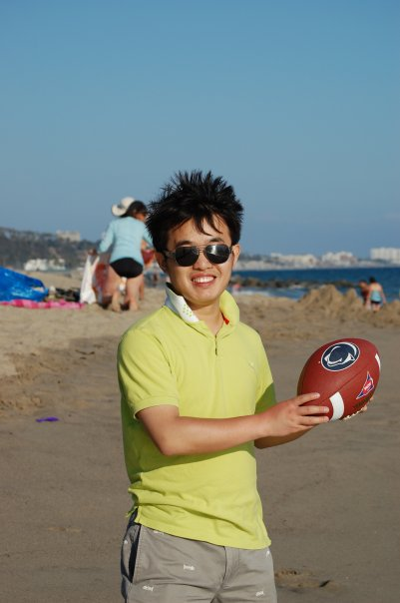
Brian – student
PhD student major in CS
Frequently go online looking for paper for his/her own research,
PAIN?
Working on his 1st or 2nd important paper
Need a comprehensive source of papers for homework and project
Check out researcher profiles (to help apply for advanced study)
Keep track of new papers
Job hunting
English as 2nd language
500K IT students in China

Slide 25
Brian - Scenarios
Notify me when something happens
Get all papers in one field
Related papers
Check the importance of journals, conferences
Name disambiguation
Find Michael Cohen
Find out the “family tree” of a scholar, to understand his/her impact

